Slide 1
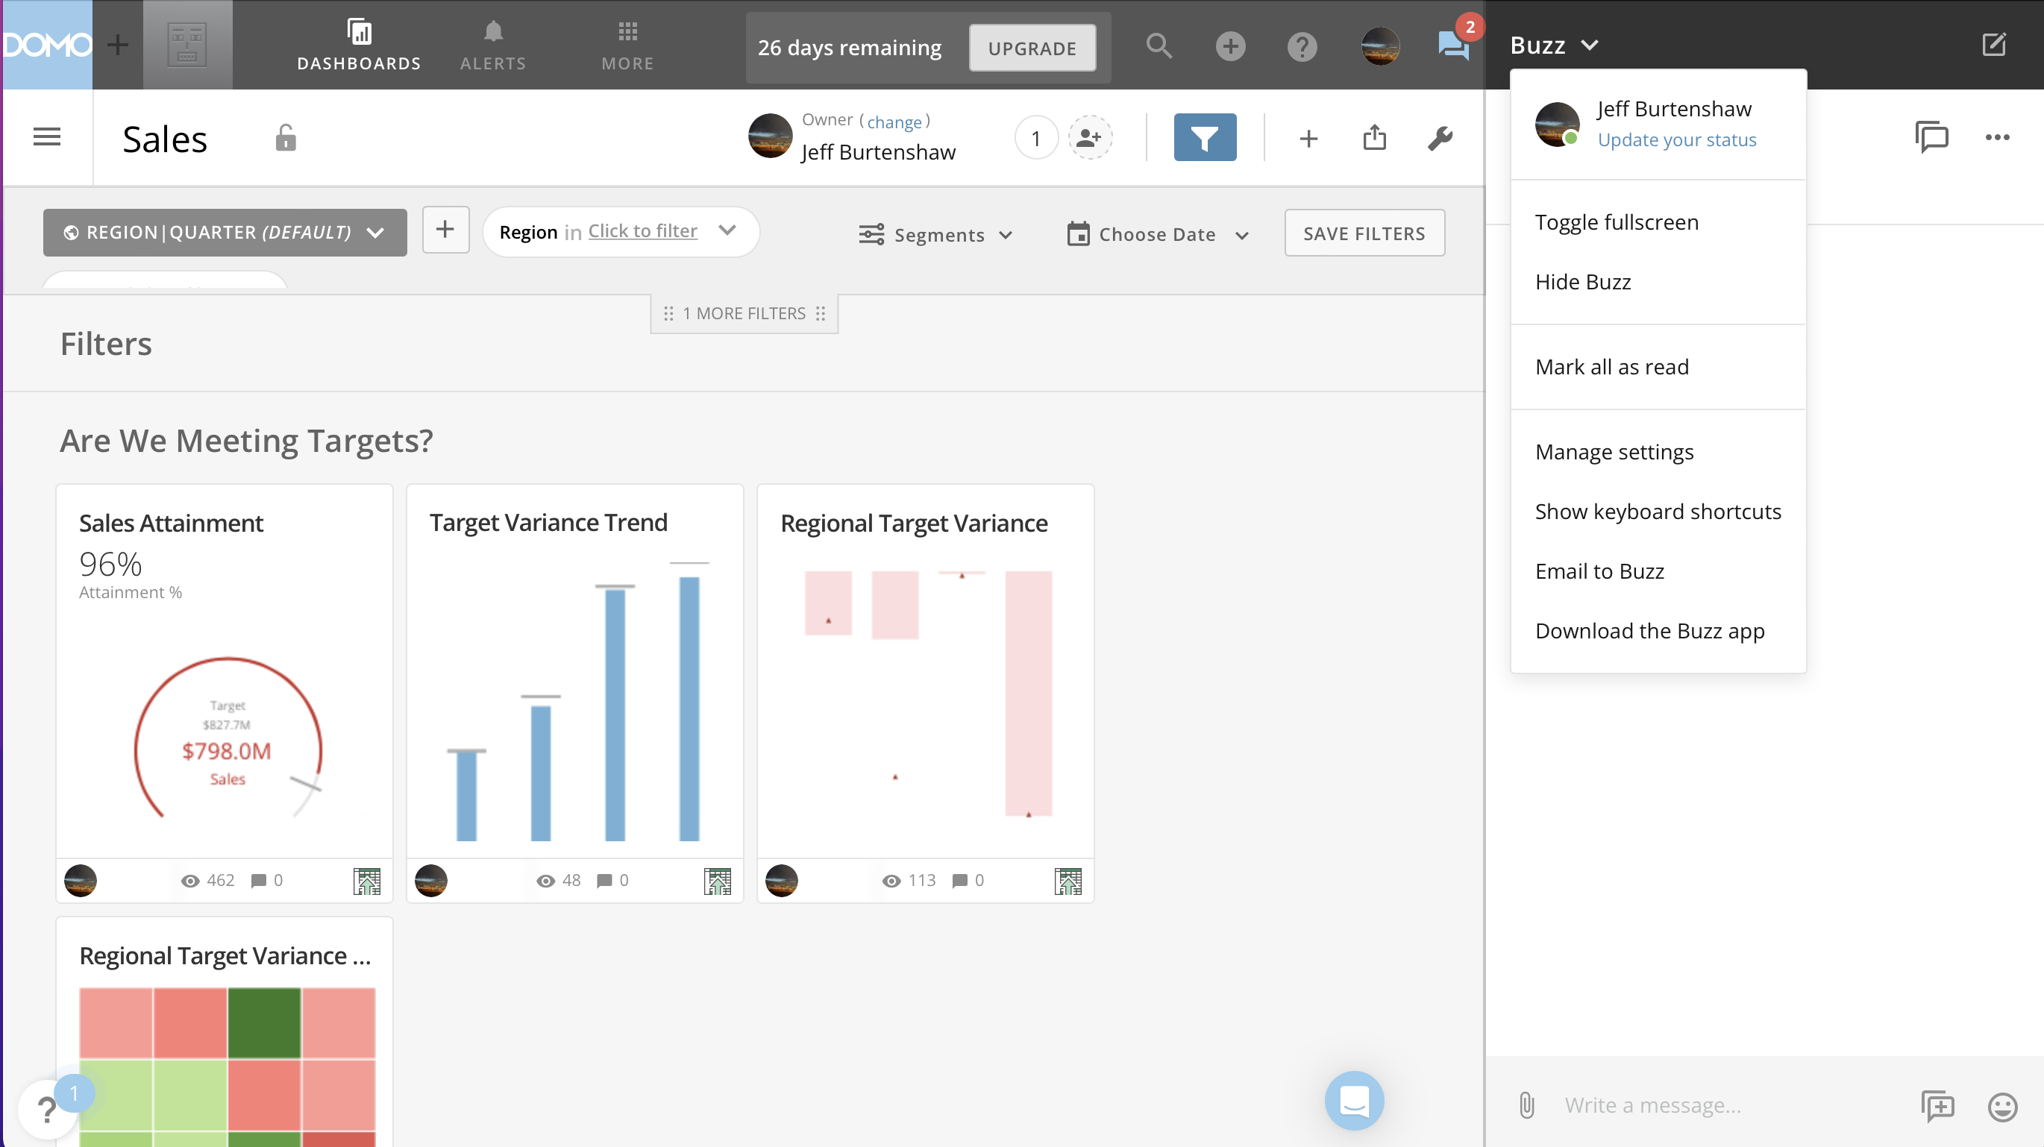
Toggle Buzz Pane
Buzz Main Menu Options
Universal Compose
Status Indicator
Buzz Pane

Slide 2
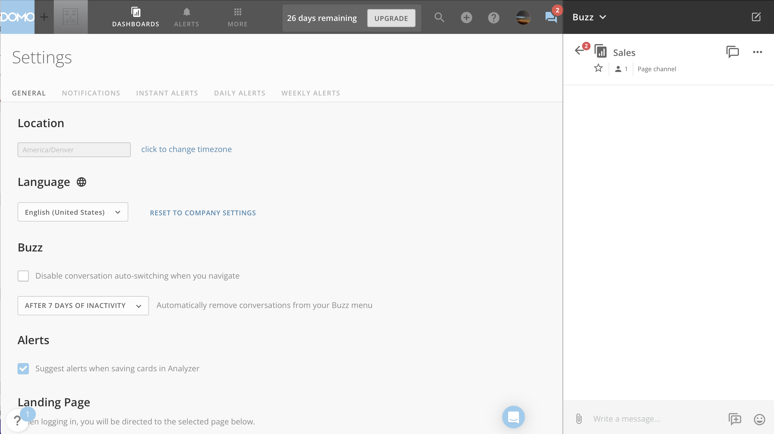

Slide 3
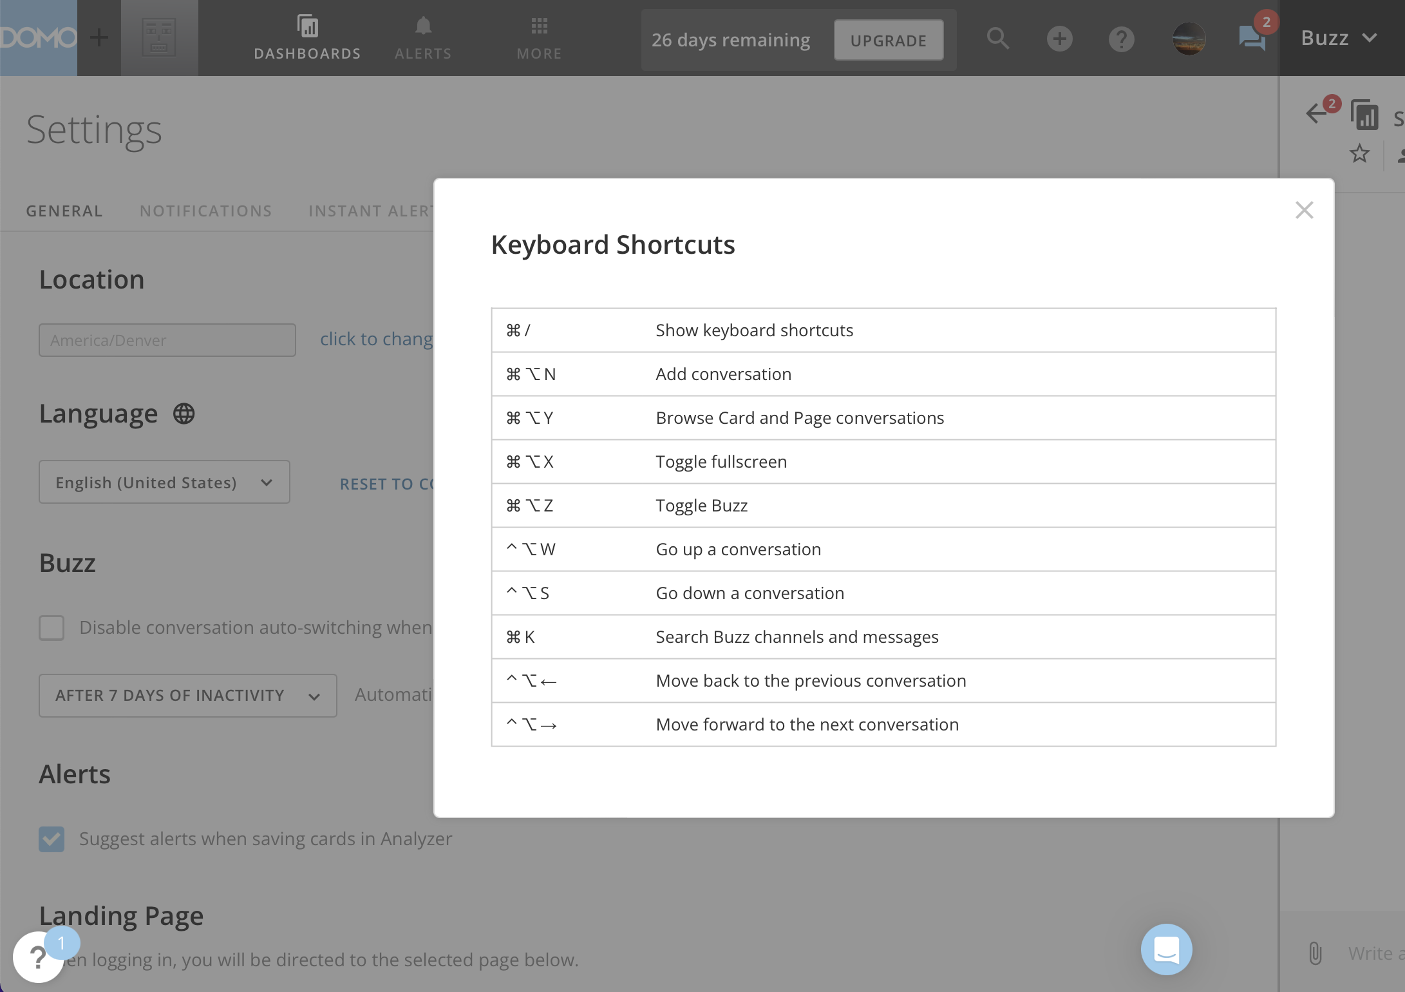

Slide 4
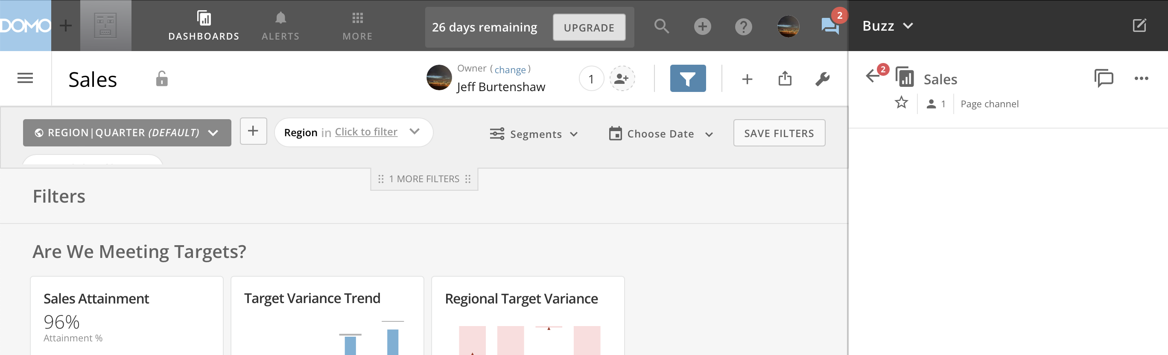
Back

Slide 5
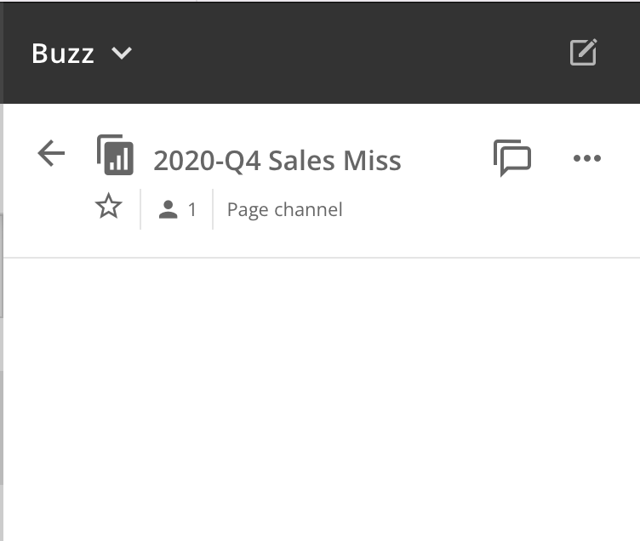
Universal Compose

Slide 6
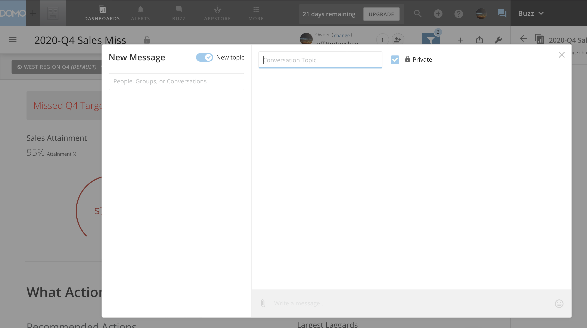
Conversation Search
New topic toggle
Topic
Private
Attachment
Message
Emoji

Slide 7
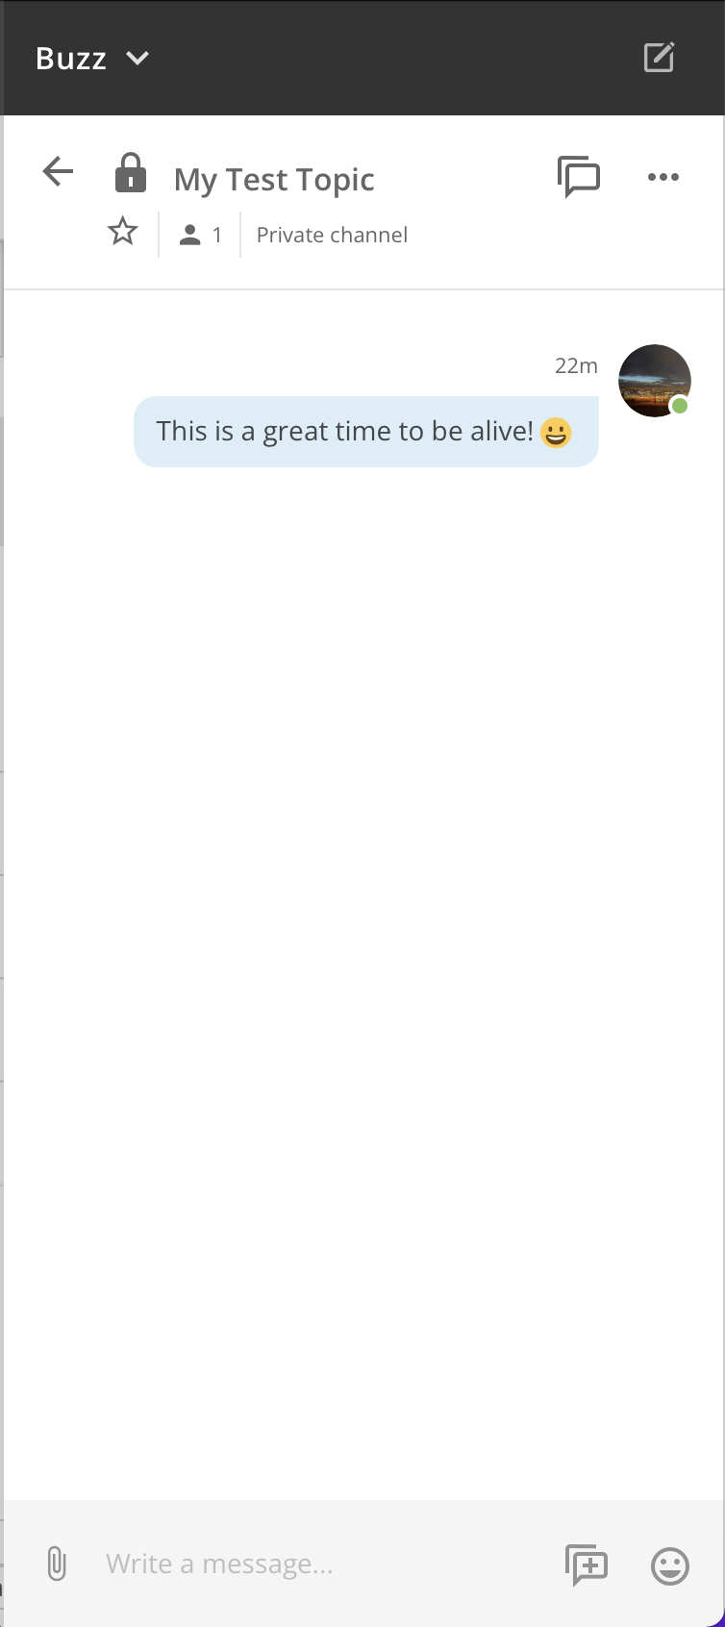

Slide 8
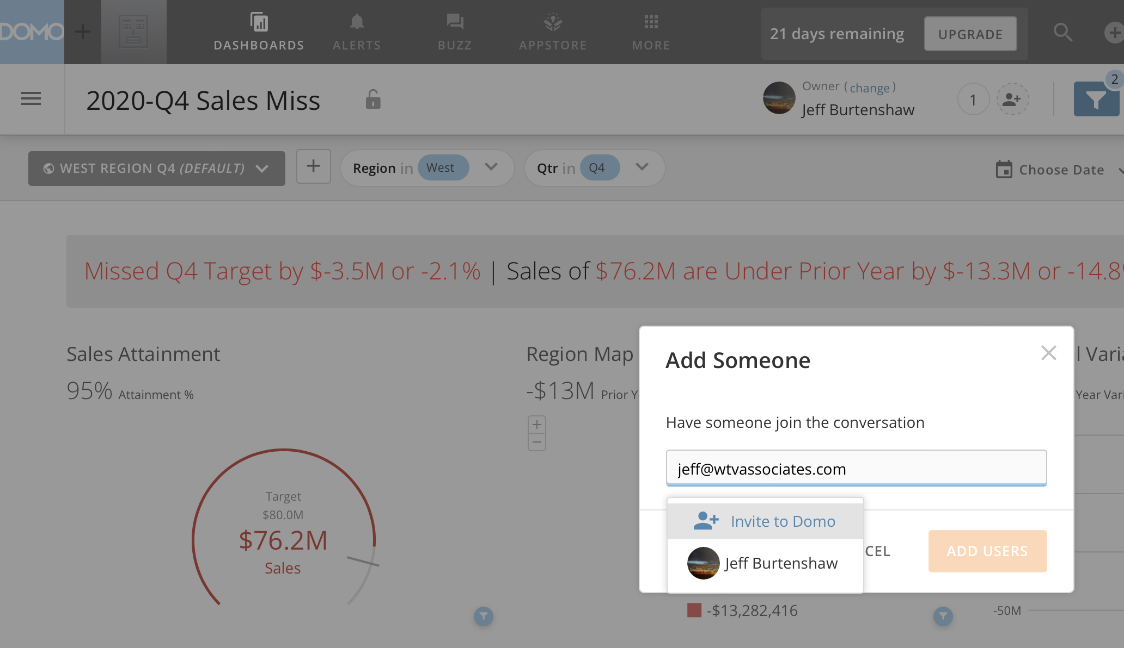

Slide 9
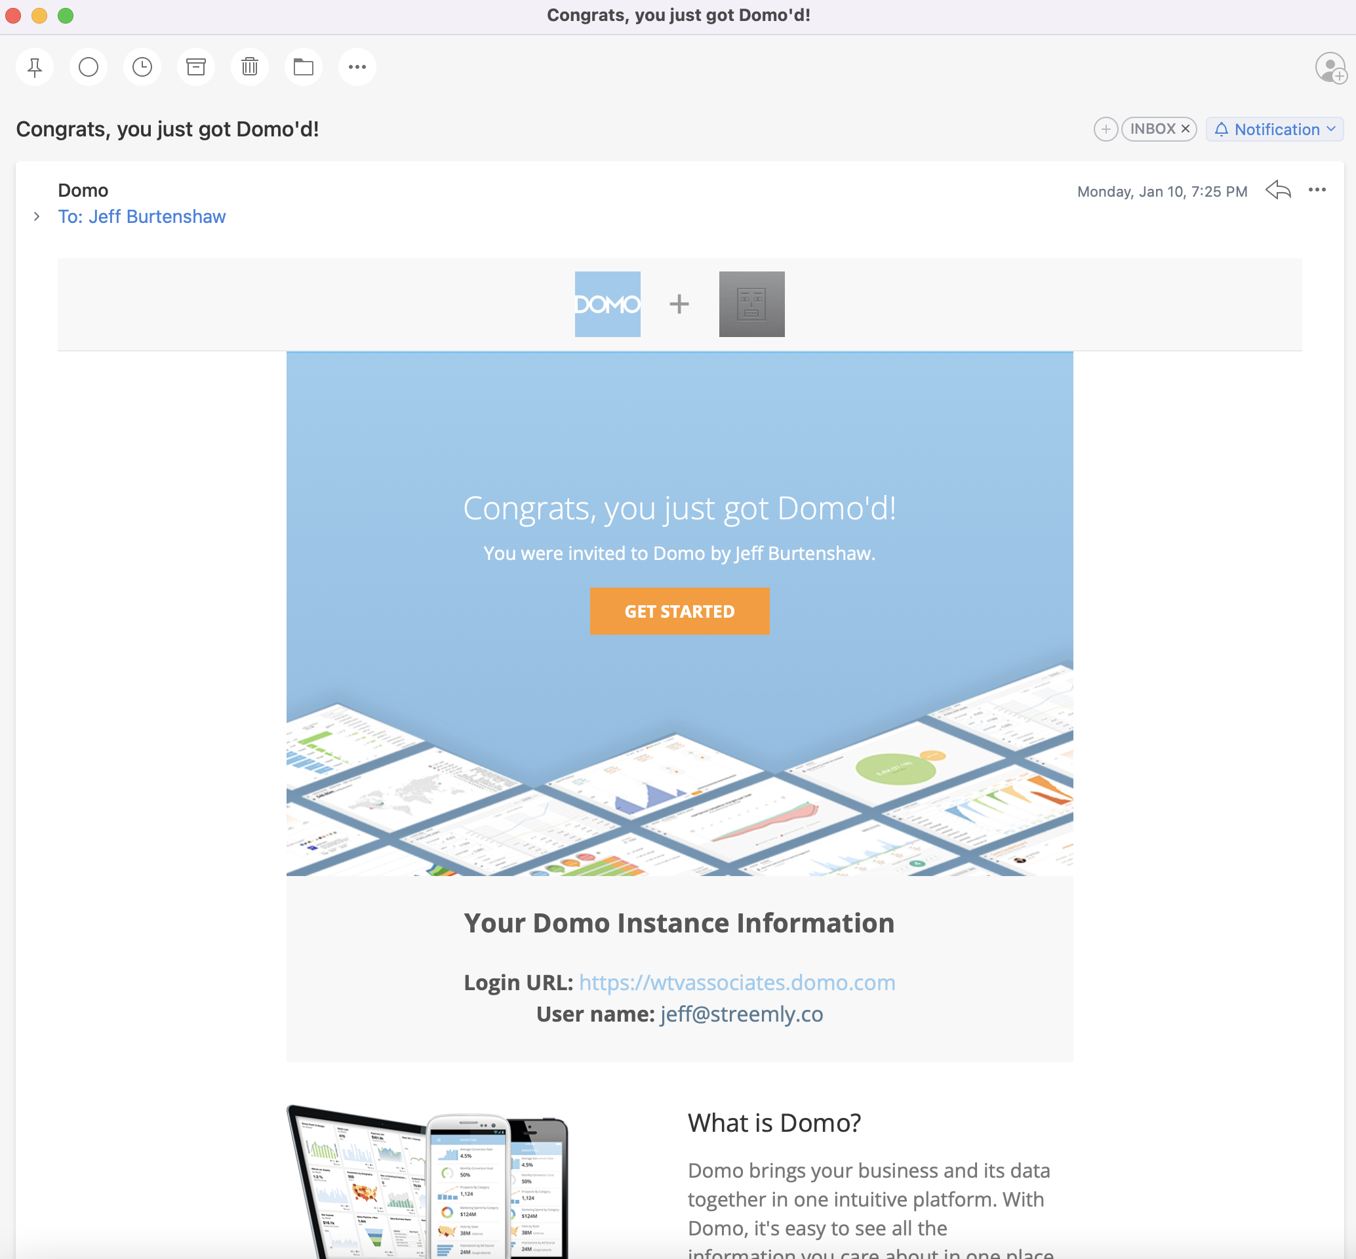

Slide 10
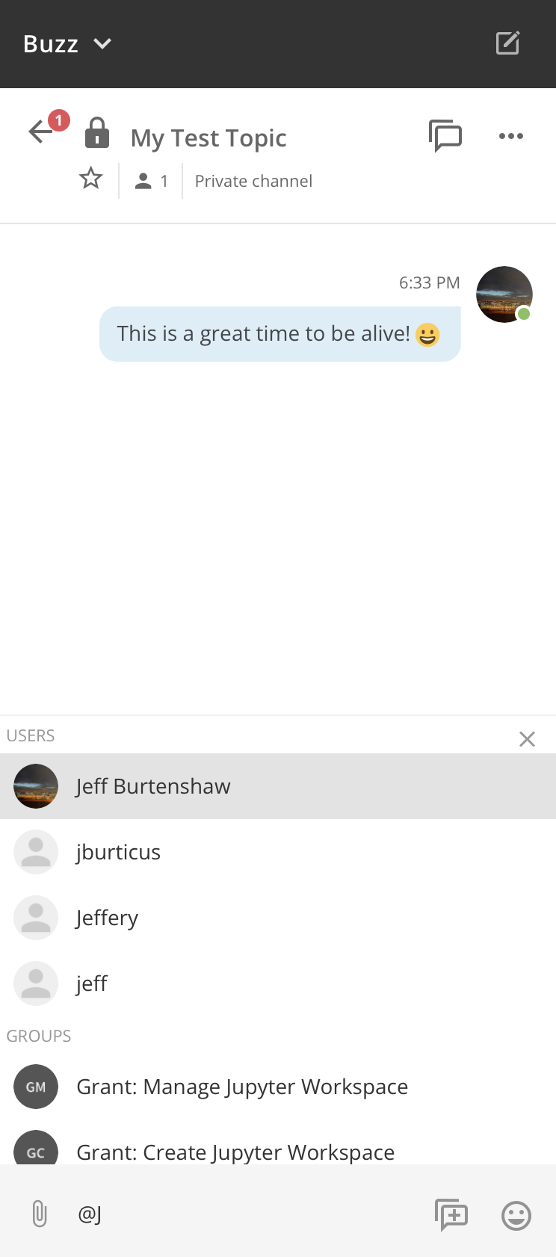

Slide 11
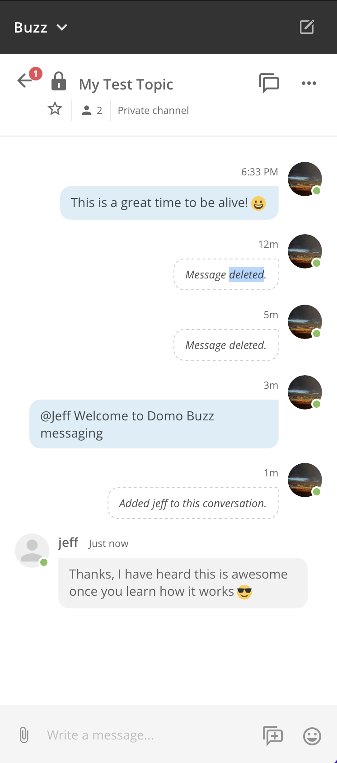

Slide 12
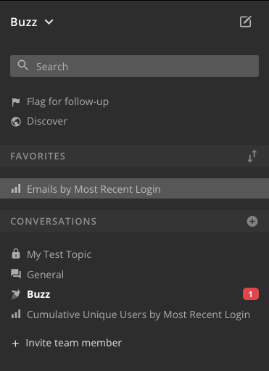
Universal Compose
Search
Follow Up Link
Discover Link
Favorited Conversations
Reorder Favorites
Current Conversation Highlight
New Conversation
Conversations
List
Unread
Invite
Conversation
Type

Slide 13
 | Public – all users in the Domo instance are members of public conversations.
 | Group – a conversation limited to specified members.
 | One on One – a private conversation between 2 people.
 | Page – conversation is related to a specific page. Only users with access to the page can participate.
 | Card – conversation related to a card. Only users with access to the card can participate.
 | Project – conversation around a project task.

Slide 14

There’s an App for That

Slide 15
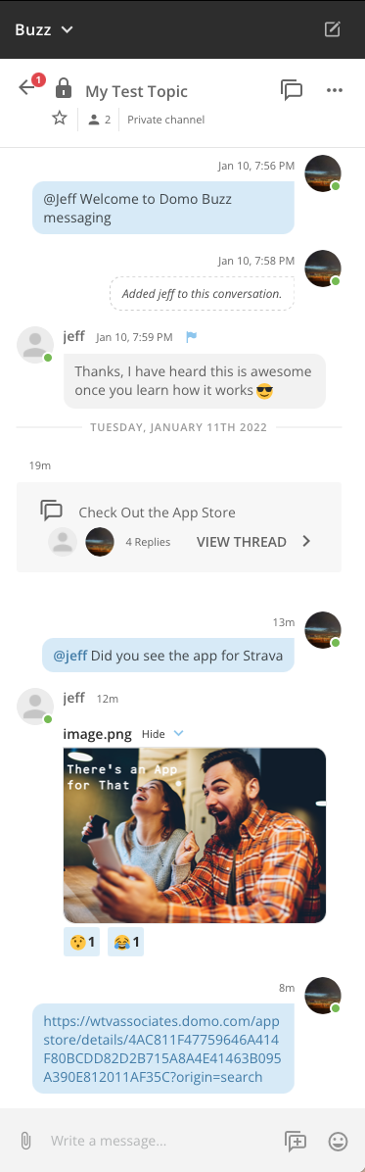
Back
Conversation Type
Detail
Unread
Topic
Thread Pane
Favorite
Sender Profile
Message
Status
Notification
Reply From
Follow Up Flag
Reply
Date Separator
Thread
@mentioned
Pasted
Reaction
New Message
Add Thread
Attach
Add Emoji

Slide 16
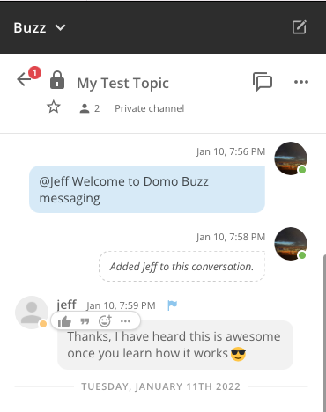
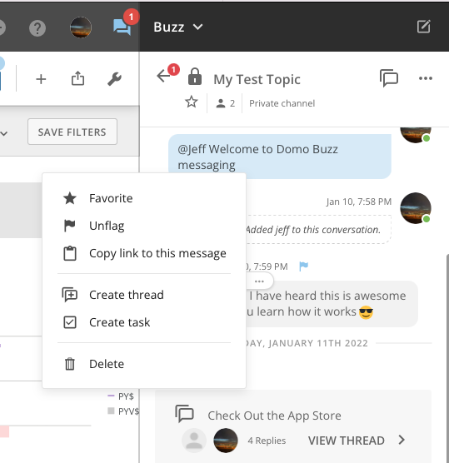
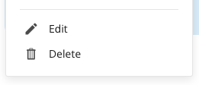
Like
Quote
Add Reaction

Slide 17
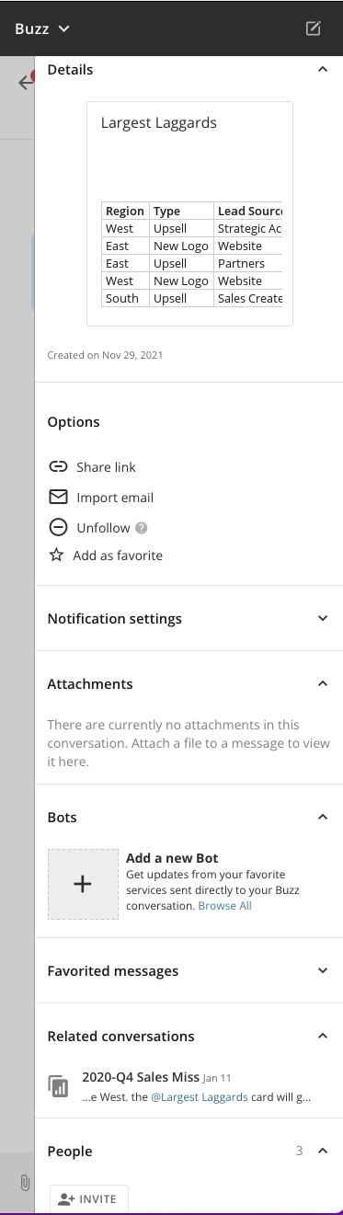
Hide/Show Section
Detail Pane
Share link
Import email
Follow/Unfollow
Favorite/Unfavorite
Notification Settings
Attachments
Bots
Conversation Favorites
Related
People

Slide 18
Conversation = Topic
Message
Reply
Thread = Sub-Topic
Message
Reply

